Slide 1
Zicklin Bright Index
Business Done Right

Slide 2
Table of Contents
Section | Page
Introduction | 3-4
About the Zicklin Bright Index | 6-8
Methodology | 9-18
Results and Conte | 19-27
Limitations | 28-29
Our Team | 30-33

Slide 3
introduction

Slide 4
Introduction
Companies significantly impact the human rights of the communities they influence.
A business is an alliance for productivity and social development. Behind a balance sheet, there are human beings with distinct rights in a vast and complex value chain that businesses should honor and protect.
In regions and countries where public sector institutions are challenged, the economic power and good governance principles of the private sector are more than simple exemplars. Businesses ideally acquire a level of responsibility regarding the human rights of stakeholders in the communities that they impact. The promotion of this responsibility highlights best practices, offers deserved recognition, prompts ethical competition, and spurs an investment in human rights.

Slide 5
Introduction
Business and human rights (BHR) standards and guidelines are advancing rapidly across industries and jurisdictions.
Companies are increasingly taking this matter seriously and making genuine efforts to ensure they respect the human rights of those they directly impact.
Until now, companies with the most distinguished record of BHR achievements have not been adequately recognized. Additionally, it was impossible to learn from BHR best practices.
There must be a tool to know who in the private sector takes BHR seriously.

Slide 6
ABOUT THE ZBI

Slide 7
The Zicklin Bright Index
The Zicklin Bright Index (ZBI) ranks companies
with the most
remarkable human
rights awareness.
Drawing on the
companies’ public
information regarding
their compliance with
international standards,
the ZBI reveals the big
picture of corporate
human rights
awareness.

Slide 8
Our History
The ZBI is part of a portfolio of rankings dedicated to providing practical, useful, and valuable information about the social impact of private corporations.
Our elder sibling is the CPA-Zicklin Index of Corporate Political Disclosure and Accountability, the only measure of electoral spending transparency and accountability among the country’s largest public corporations.
Issued annually, it’s produced by the Center for Political Accountability in conjunction with the Zicklin Center for Governance and Business Ethics at the Wharton School at the University of Pennsylvania.
Learn more about the CPA-Zicklin Index here:
https://www.politicalaccountability.net/cpa-zicklin-index/

Slide 9
METHODOLOGY

Slide 10
Foundation of ZBI Factors and Indicators
ZBI factors and indicators, fashioned for the Andean region, are the product of countless hours of research by our dedicated team. These indicators draw inspiration from key international legal instruments, both binding and non-binding. Our measures reflect elements from:
ILO’s Fundamental Conventions
The American Convention on Human Rights
The UN Declaration on Human Rights
The UN Guiding Principles on Business and Human Rights
The UN Global Compact
The OECD Guidelines for Multinational Enterprises on Responsible Business Conduct

Slide 11
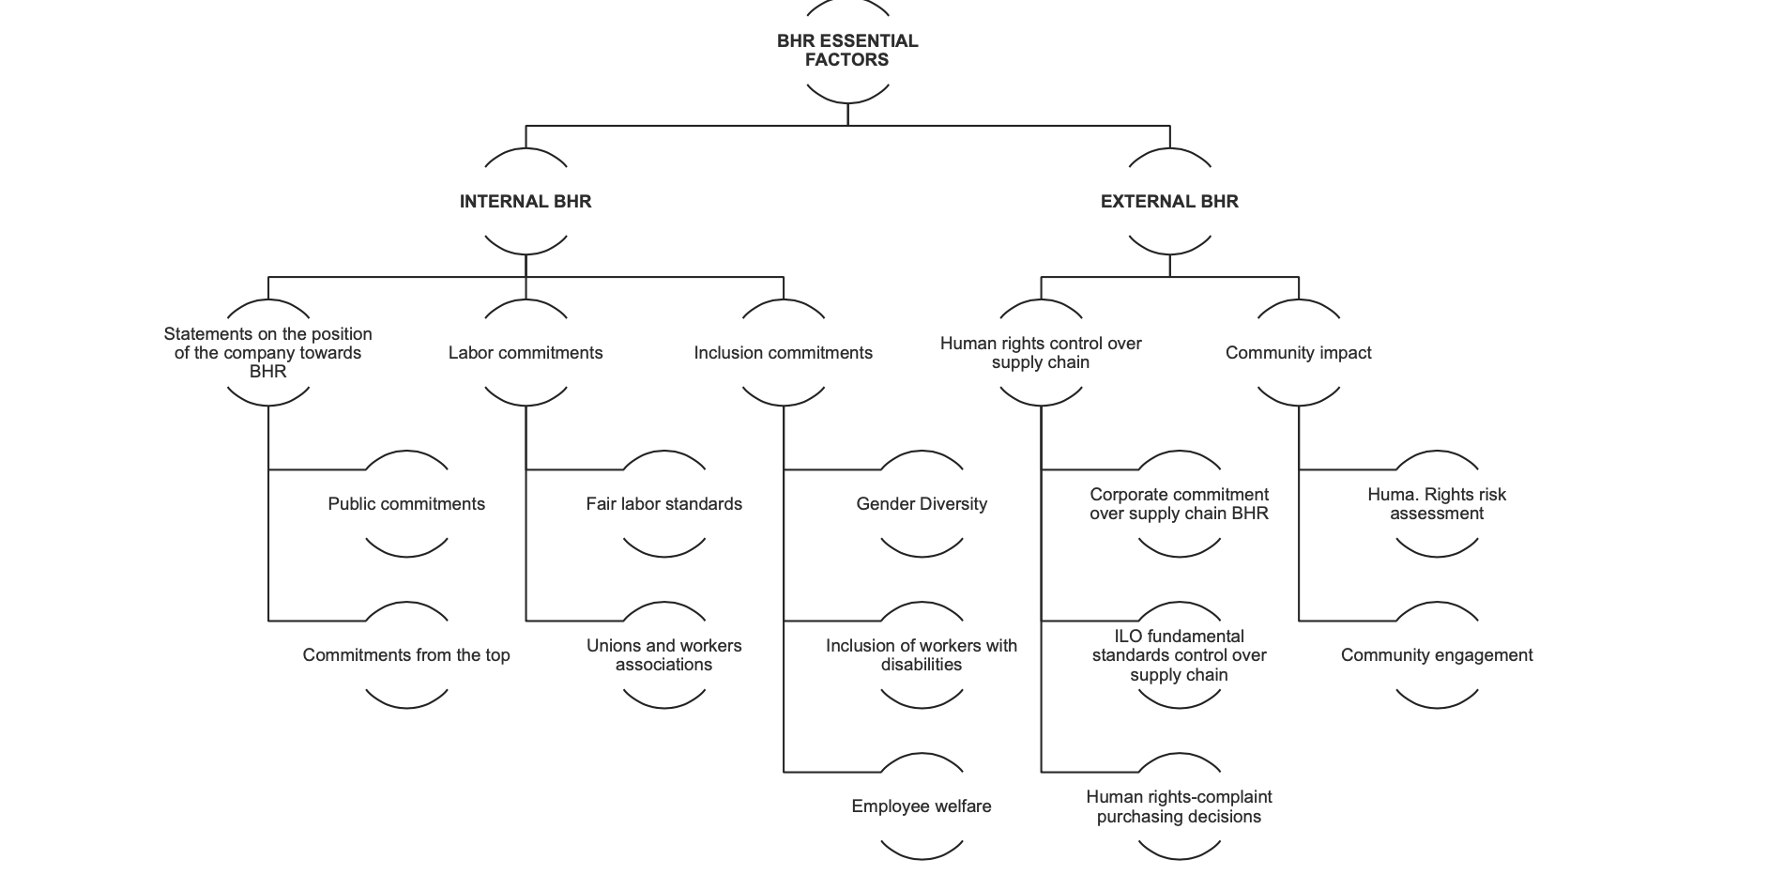
By: Jorge Anhalzer
23 Indicators Across 8 Factors

Slide 12
Our Objectives

Slide 13
How?
The ZBI ranks companies based on publicly available information.
The ZBI does not endeavor to capture actual BHR performance. Instead, we rank order corporate self-recognition of BHR accomplishments
Disclosure is itself a social good as it reflects the statement and the philosophy of the corporations toward human rights and social responsibility.

Slide 14
Tier System
Tier | General Description | Score
Tier 1 | Excellent disclosure. The company has clear public statements about Business and Human Rights practices. The team was able to navigate easily through sustainability, human resources, and human rights reports to have a clear picture of how the commitment of the company looks towards BHR-related issues. | 89-100
Tier 2 | Good disclosure practices. The company has a position in most of the BHR indicators. Information can be found relatively easily. There are more than three areas in which the company needs to improve its practices. | 80-89
Tier 3 | Acceptable disclosure practices. The company has information and shows some level commitment. However, either the information is difficult to find, or it lacks sufficient data on at least five indicators of the ranking. | 70-79

Slide 15
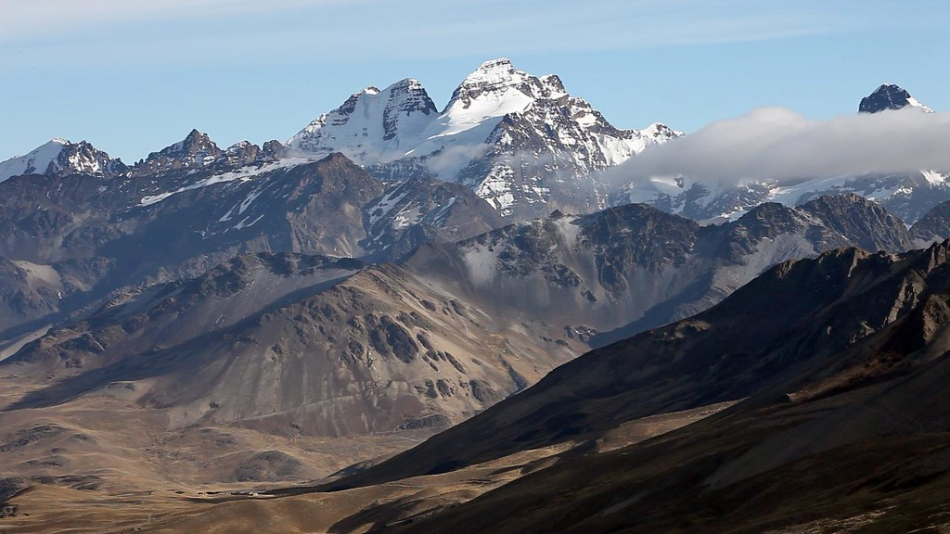
ZBI 2023 Beta Edition
The Andes

Slide 16
Methodology
Team Assembly: Eight research assistants from Ecuador, Peru, and Colombia were onboarded and trained in effective BHR data collection from websites and social media platforms.
Scoring Criteria: A scoring rubric was crafted, with researchers instructed on its optimal application during their research.
Stakeholder Communication: All target companies received notification about the ZBI and the dimensions that would be assessed.

Slide 17
Methodology
Collaboration: Findings were pooled, discussed, and endorsed by all research assistants.
Initial Compilation: Data was organized, and the preliminary "Top 10 Bright of the Andes" were internally reviewed.
Final Approval and Release: Following the advisory board's endorsement of the scores and ranking, the ZBI is slated to be unveiled. Engagements with top-performing companies is planned.

Slide 18
Research Journey
150 Companies
1500+ documents reviewed
25+ Meetings
300+ hours of research

Slide 19
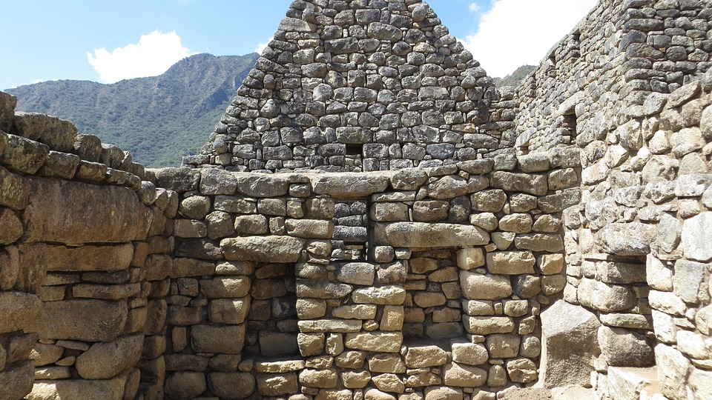
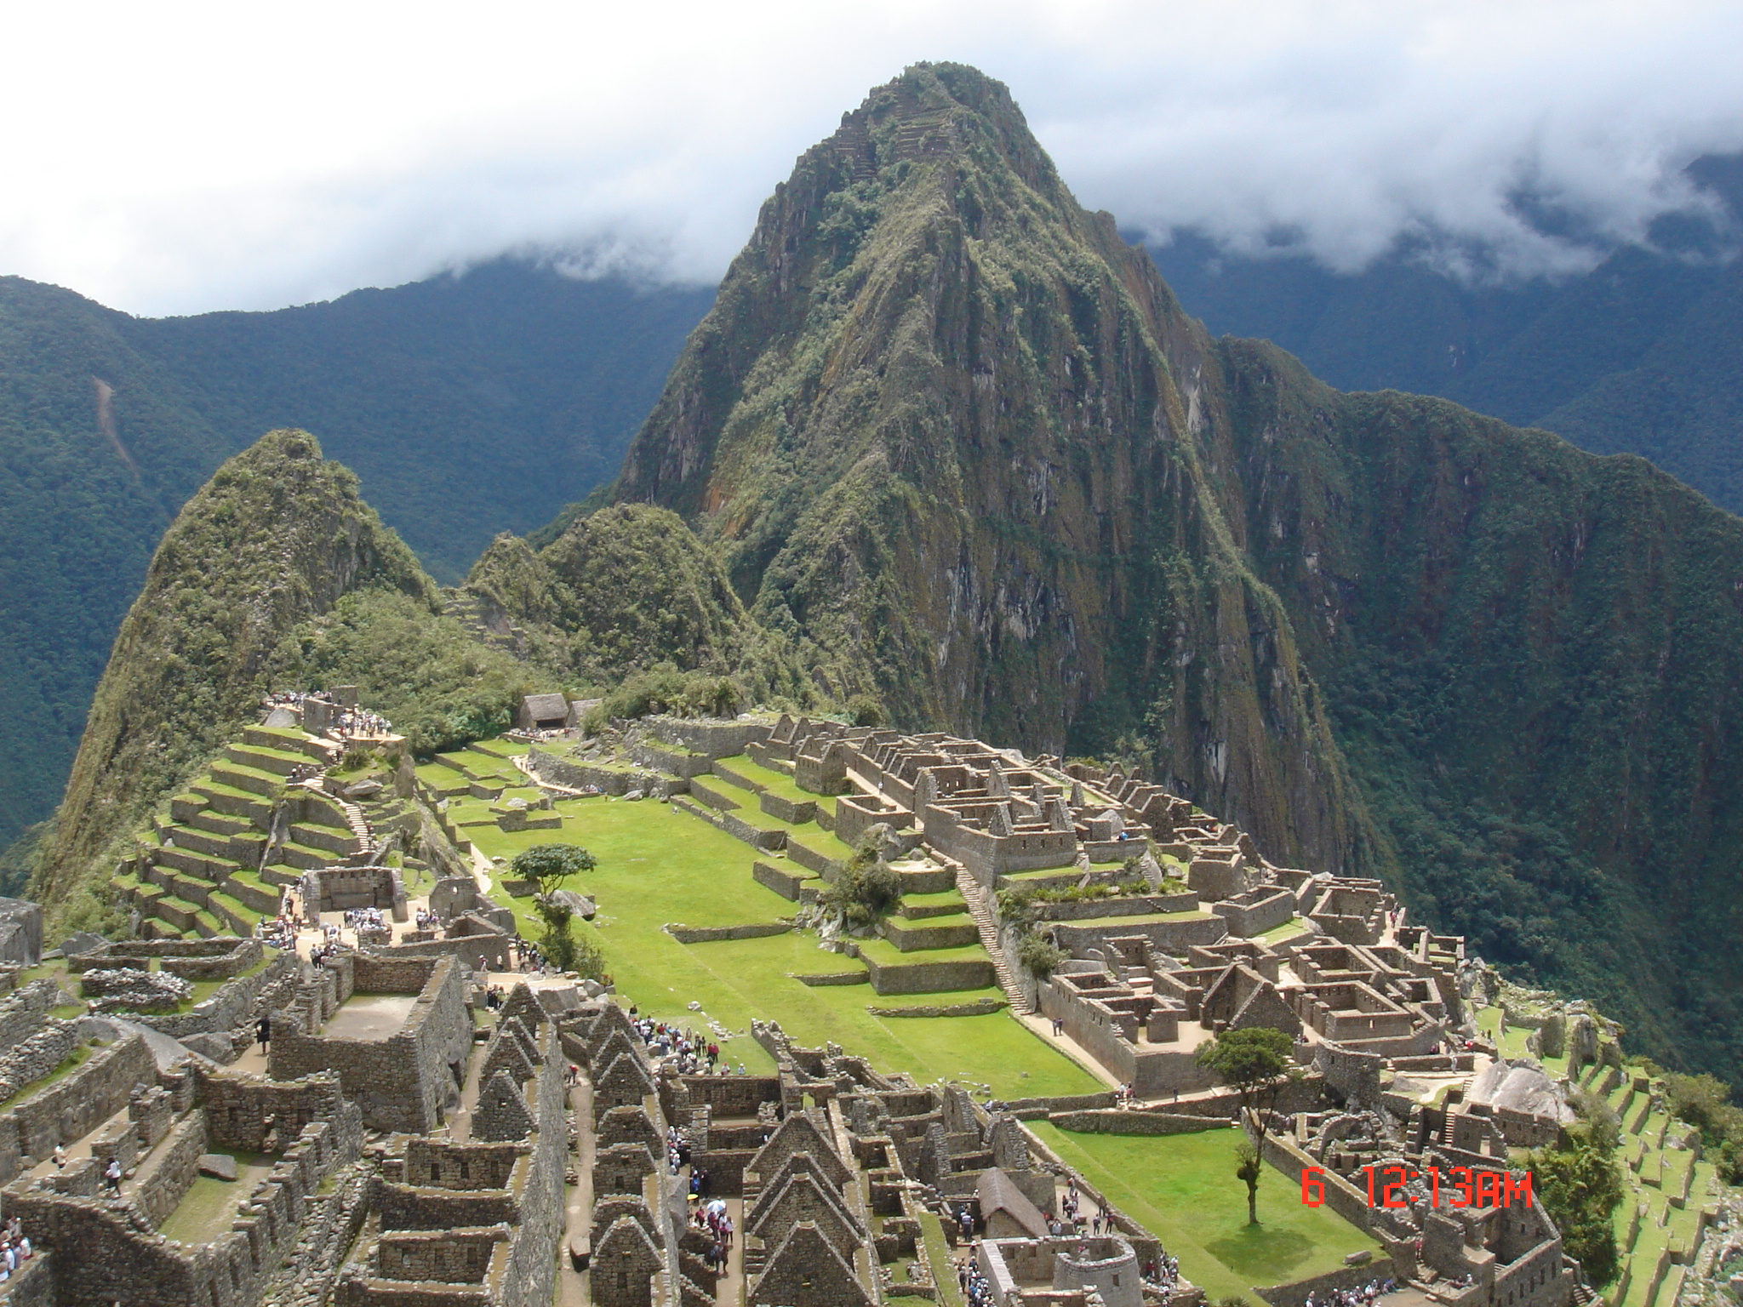
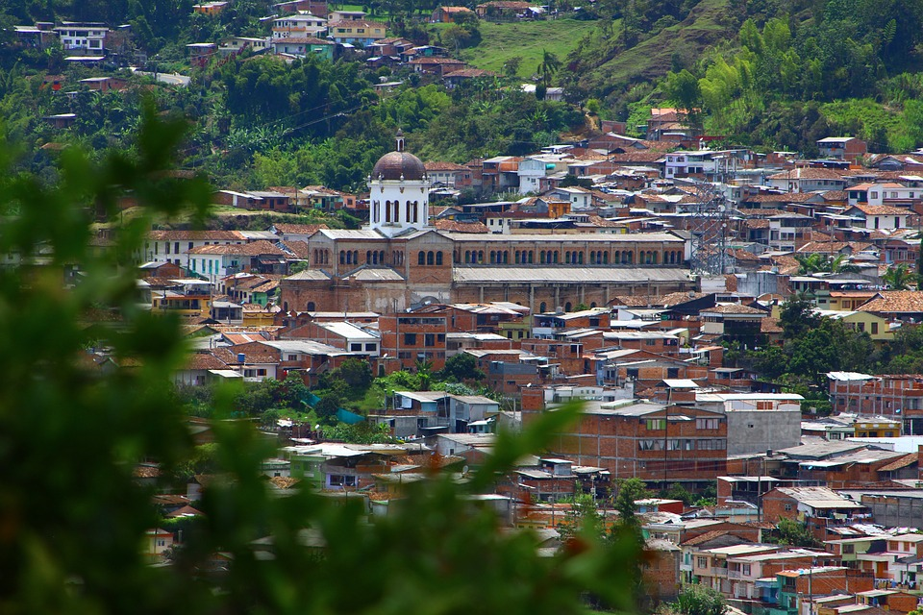
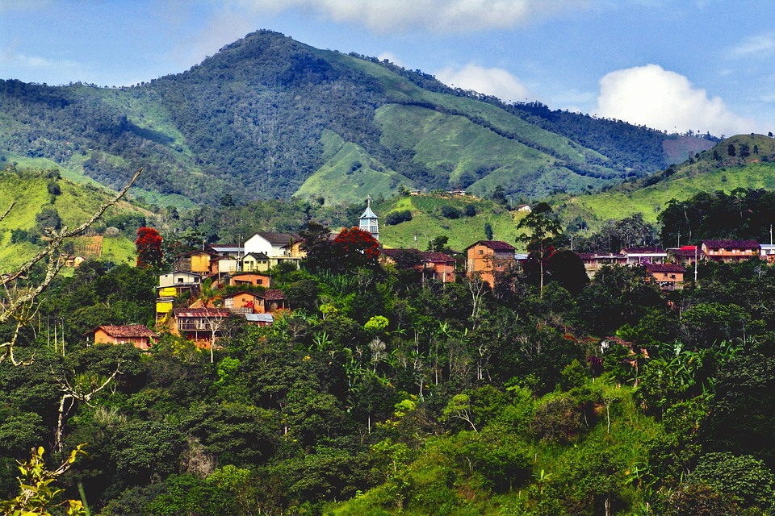
RESULTS

Slide 20
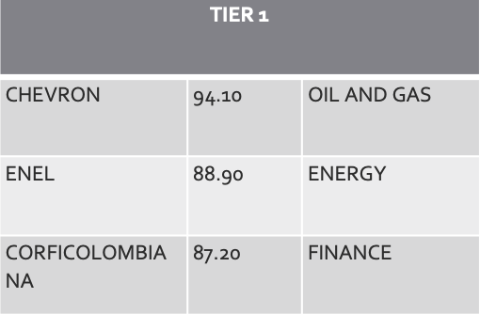
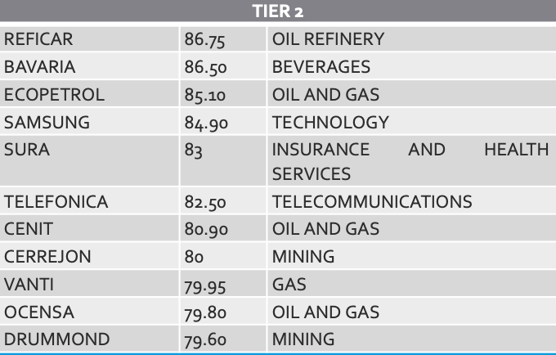
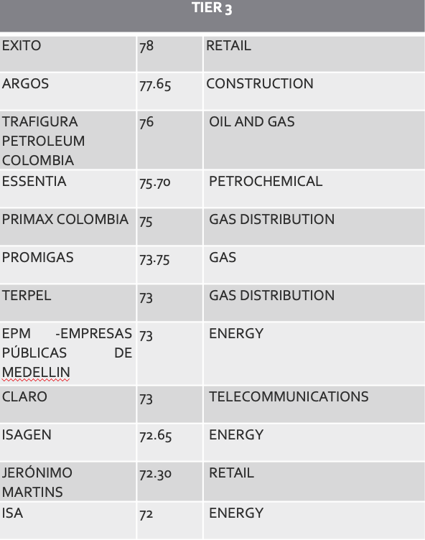
Colombia

Slide 21
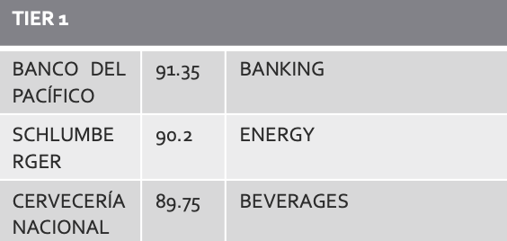
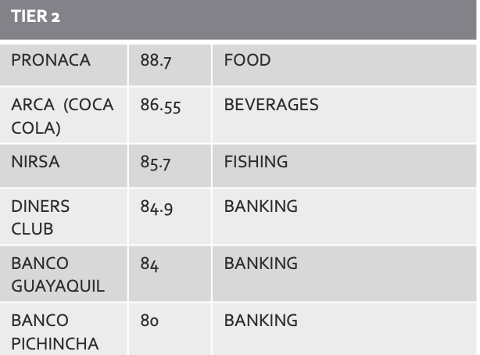
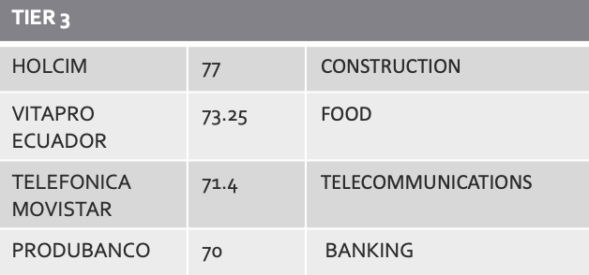
Ecuador

Slide 22
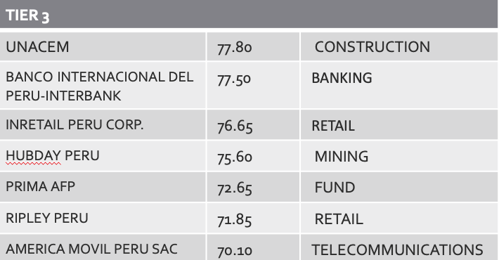
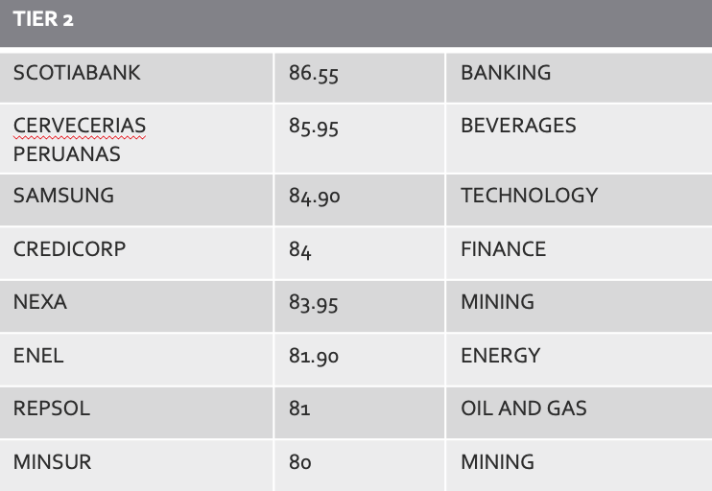
Peru

Slide 23
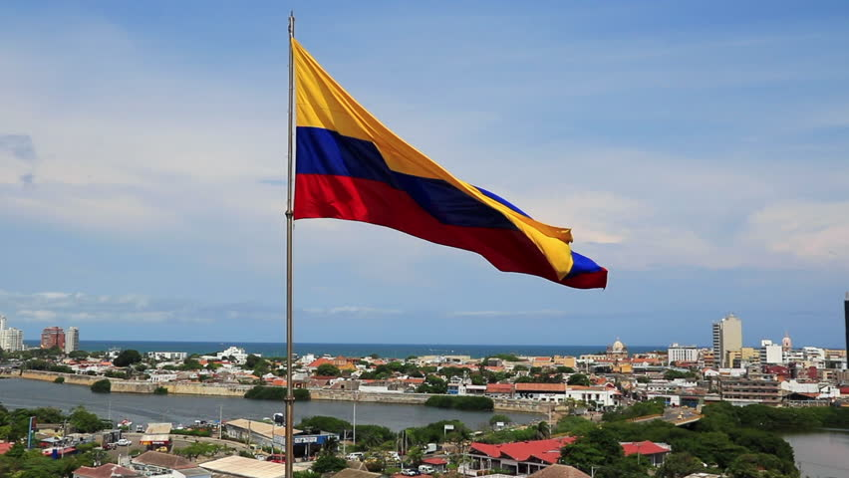
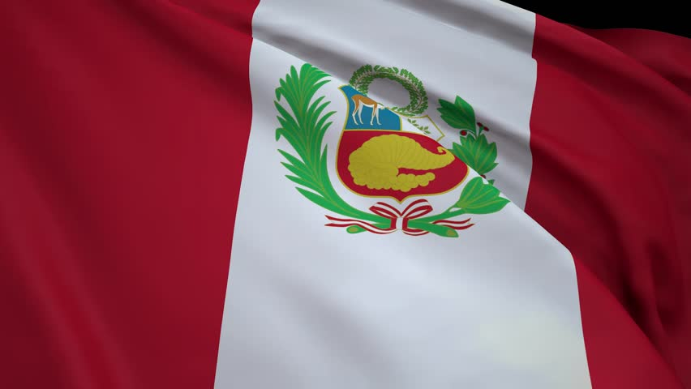
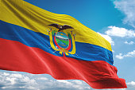
Results in Context: Colombian Companies Lead the ZBI Ranking
1
2
3
Colombia
Peru
Ecuador

Slide 24
ZBI Results Compared with Other Rankings
We compare our results with:
Transparency International's Corruption Perceptions Index
World Bank's Ease of Doing Business Index
Freedom in the World Report by Freedom House

Slide 25
Transparency International’s 2022 Corruption Perceptions Index
1. Colombia: 91
2. Peru: 101
3. Ecuador: 101

Slide 26
World Bank’s 2022 Ease of Doing Business Index
1. Colombia: 67
2. Peru: 76
3. Ecuador: 129

Slide 27
Freedom Index’s Freedom in the World Report
1. Colombia: 70 - Free
2. Ecuador: 70 - Free
3. Peru: 70 – Partly Free

Slide 28
LIMITATIONS

Slide 29
Limitations of This Edition of the ZBI
Greenwashing: Companies could exaggerate or falsely promote their human rights initiatives, attempting to appear more socially responsible than they genuinely are.
Reliance on Self-reported Data: Our research is exclusively based on information provided by the companies themselves. As we lack on-the-ground verification, the “real” impact of disclosures is not part of the scope of this beta ZBI.
Peer Review Process: The ZBI utilizes objective and impartial researchers with trained to explore the public digital profiles of companies and collect pertinent information about their BHR practices. While these findings were subsequently verified by peer researchers, minor variations may be due to inter-rater variance.
Audit: Although we do not audit companies, the ZBI will move in that direction in the future.

Slide 30
OUR TEAM

Slide 31
Our Team
Project Director: Victor D. Cabezas Alba - University of Pennsylvania Carey Law School
Faculty Advisor: William S. Laufer – Professor of Legal Studies & Business Ethics, Sociology, and Criminology, Wharton School, University of Pennsylvania; Co-Director, Zicklin Center for Governance and Business Ethics
Research Assistants: Veronica Arias, Maria Irias Cardenas, Raymond Liu Ao
Past Researchers:
Colombia: Mariana Mejía, Estefanía Olmos
Ecuador: Carolina Borja Ortega, Andrea Hidalgo Castex, Gabriela Jácome Aguirre, Rafaella Romo-Leroux Chacón
Peru: Francesca Fernandini, Fiorella Ruiz del Campo

Slide 32
About the ZBI
The Zicklin Bright Index is sponsored by the Carol and
Lawrence Zicklin Center for Governance and Business
Ethics.
The Zicklin Center is housed under the ESG Initiative at the Wharton School of the University of Pennsylvania
The Center sponsors and disseminates leading research
on critical topics in business ethics. It provides students,
educators, business leaders, and policymakers with
research to meet the ethical, governance, and compliance challenges that arise in complex business transactions.

Slide 33
Zicklin Bright Index
Business Done Right

